Slide 1
Competition between chemotaxing growth and yield strategists in non-mixed environment
BIOE 311 Final Project
March 18, 2015
Esha Atolia and Michael Song

Slide 2
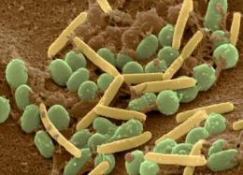
Introduction: Microbial Competition
Many different strategies to win
Spatial organization
Cooperation (Altruism or Mutualism)
Cheating
Quorum Sensing

Slide 3
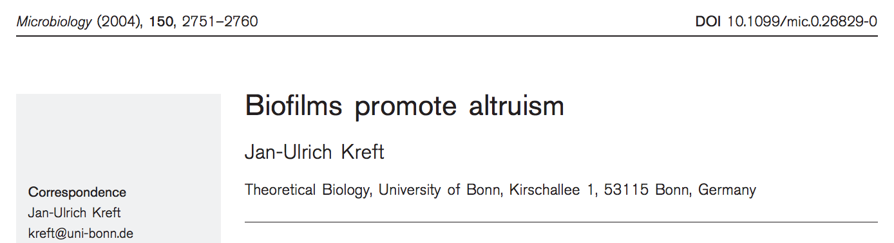
YS, yield strategy (altruists) | high growth yield at the cost of low growth rate
GS, growth rate strategy | high growth rate at the cost of low growth yield
In a well-mixed, the GS strategist will always outcompete the YS strategist.
YS can outcompete GS in a structured biofilm
Notes:
Abbreviations: YS, yield strategy – high growth yield at the cost of low growth rate; RS, rate strategy – high growth rate at the cost of low growth yield.

Slide 4
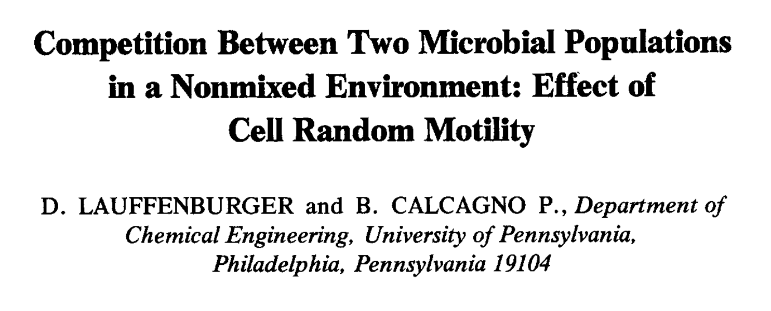
There may be as many as three possible non-trivial steady-state
The coexistence state can exist even though one species possesses a smaller intrinsic growth rate constant at all nutrient concentrations, if that same species is sufficiently less motile than the other species.
Notes:
There may be as many as three possible non-trivial steady-state (or longtime) configurations: when species 1 survives, species 2 dies out; when species 2 survives, species 1 dies out; and species 1 and species2 Coexist. 2) The coexistencestate can exist even though one species possesses a smaller intrinsic growth rate constant at all nutrient concentrations, if that same species is sufficientlyless motile than the other species. 3) In fact, the specieswith the smaller maximum specific growth rate may grow to a larger population than the other. 4) The possibility of coexistence can be decided essentially from the results for single population growth.’

Slide 5
Methods
Utilized agent-based model with two types of cells (YS and GS) chemotaxing in continuous space
An underlying (discrete) grid keeps track of nutrient concentrations in the environment
Nutrients are replenished uniformly over time
Each cell moves, consumes nutrients, decides whether or not to divide/die with each time step
Parameters: growth rate, growth yield, death rate, nutrient consumption rate

Slide 6
Methods
sample cell
For each time step:
process collisions with walls/other cells (update position)
consume nutrients and update velocity based on chemotaxis
check division
check death
all cells consume nutrients from closest grid point (distributed evenly if not enough)
if nutrients consumed > 1/yield rate
&
age of cell > 1/growth rate
place new cell
if age exceeds 1/death rate or has not consumed enough nutrients in certain time period
delete cell

Slide 7
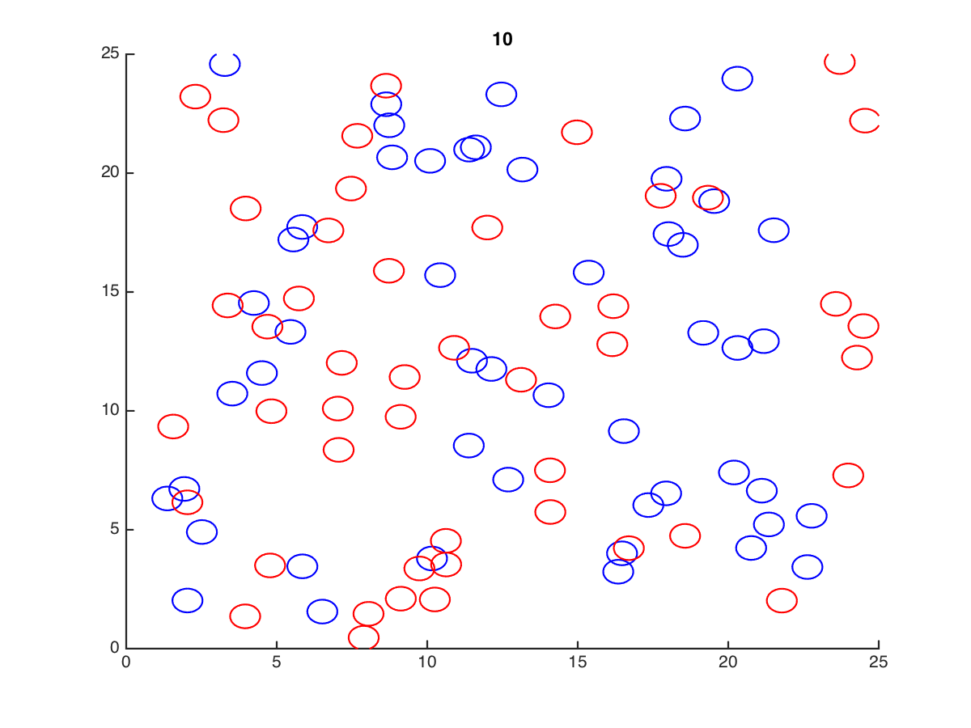
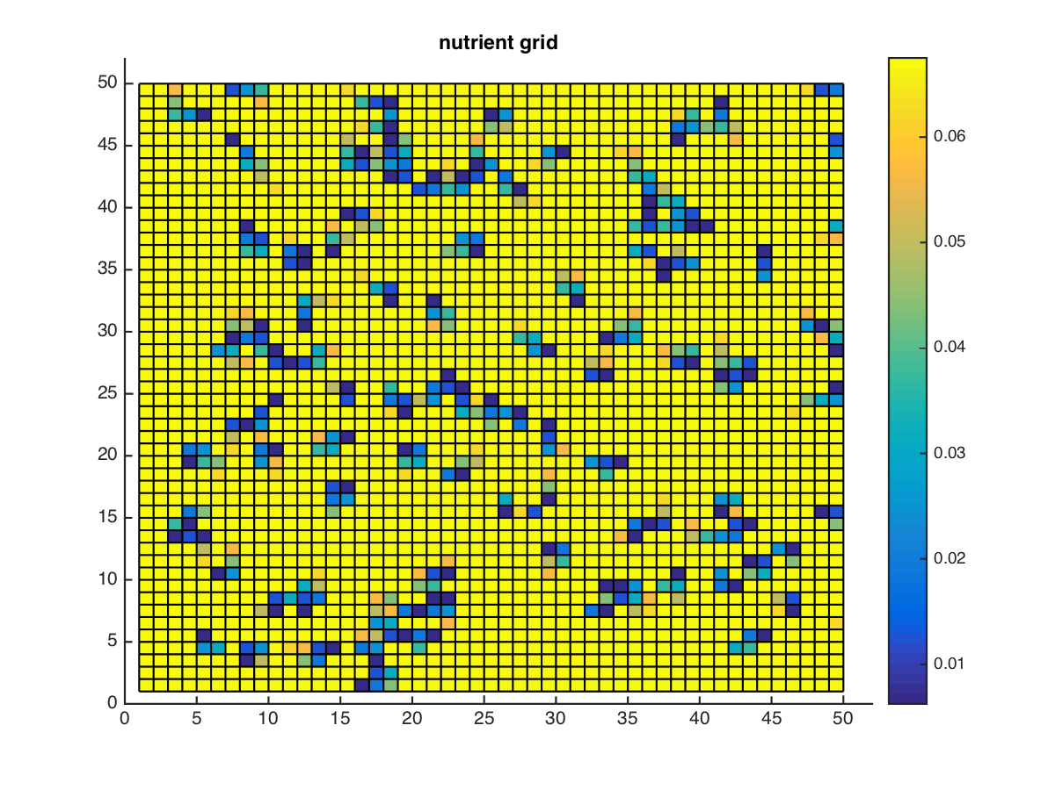
Simulation

Slide 8
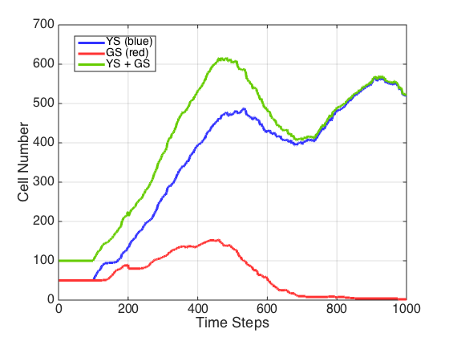
YS win under all yield and growth ratio conditions
YS |  | GS
Yield Rate | > | Yield Rate
Growth Rate | < | Growth Rate

Slide 9
Results
To test effects of changing nutrient availability, set YS and GS parameters such that GS has slight advantage in division time when nutrients are abundant
Test initial starting nutrients and nutrient replenishment rate
regardless of nutrient availability, YS still dominates over time as long as even one YS cell survives (show graphs)
Also tested seeding density of YS and GS cells
Even if significantly more GS cells at start, YS will outcompete them

Slide 10
Discussion
Limitation of model is that if YS outcompetes GS under any nutrient condition, if a single YS survives it will always dominate over time (GS has to completely outcompete it to persist which is unlikely)
Need to improve collision detection/cell placement to better model clustering/patchiness
Model needs to be refined significantly in order to be able to draw biological insights from it
agents must exhibit larger spectrum of realistic behaviors (need to vet assumptions/simplifications in more depth)

Slide 11
Future Improvements
Improve collision detection and placement of divided cells
Develop more analytical tools to assess trajectory/steady state
quantify “patchiness” of final state, etc.
Simulate different nutrient consumption rates/death rates between GS and YS?
Better traverse the parameter space of yield rate and growth rate to see if other steady states exist

